Slide 1
What Is Infringement?

Slide 2
What Is Infringement?
Infringement refers to the unauthorized use of protected material under intellectual property laws.
This usually refers to instances of copyright infringement, such as when artistic works, music, or literary works are used without the creator’s approval. However, infringement can also involve other categories of intellectual property law, including trademarks and patents. In recent years, domain name infringement has also become a standard legal dispute.

Slide 3
What Is Copyright Infringement?
According to intellectual property laws, a copyright is a legal right created in an author’s work. Copyrights provide the author of new and creative work with the exclusive publication, distribution, and usage rights for their work. Copyright prevents other people from using the author’s initially authored work without their permission.
Under copyright law, copyright permits an author to have many exclusive rights. Some examples of such exclusive rights include the right to:
Reproduce the copyrighted work as wanted;
Distribute copies of the copyrighted work to the public for sale; and
Perform the copyrighted work as desired.

Slide 4
Some models of copyrightable works include, but are not limited to:
Books;
Poems;
Song lyrics, musical compositions, and sound recordings;
Plays, motion pictures, and scripts;
Paintings and drawings;
Choreography;
Sculptures;
Software;
Broadcasts; and
Websites and online content.

Slide 5
the following are some examples of copyrights and common copyright infringements:
Infringement of the Right of Reproduction
Infringement of the Right of Public Performance
Infringement of the Right of Distribution
Infringement of the Right of Public Display

Slide 6
What is the First Sale Doctrine?
The first sale doctrine, or the right of first sale or first sale rule, is a legal concept that enables an owner of a good embodying a copyrighted work to resell it and defines the limitations for the resale.
When someone buys a video game or a book or a movie, it insinuates that they own the item they bought. They do not own the underlying intellectual property, but they own the tangible thing they’ve purchased. For copyright protected products, this creates a secondary market.
A copyright owner gets the exclusive right to “to distribute copies or phonorecords of the copyrighted work to the public by sale or other transfer of ownership, or by rental, lease, or lending.”

Slide 7
When does first sale doctrine apply?
Lawful ownership of the copy is required. This means the first sale doctrine doesn’t apply if the possession of the copy is via rental, lease, loan or any other means that don’t involve acquiring legitimate ownership of the item.
This leads to confusion in digital sales. Software distributors and digital publishers often make clear in their EULAs that their content is licensed, not sold. A license is a much more limited right of possession and use – not ownership. The first sale doctrine doesn’t apply.
The first sale doctrine is somewhat at odds with the Copyright Act. The primary example is if a piece of artwork is purchased (for example, a famous work by Picasso) – the purchaser owns the rights to that thing. But the purchaser doesn’t own the copyright. They cannot then go and make copies, mugs, t-shirts or tote bags with the Picasso artwork on the items.

Slide 8
What is fair use?
A fair use is the copying of copyrighted material for the purposes of comment, criticism, or parody.
In a nutshell, a fair use constitutes copying of material for a “transformative” reason. In layman’s terms, it determines whether the material you’re borrowing from someone else has been used for a fair purpose. Or else, if your use breaks copyright or other laws.
Fair use applies to all sorts of media:
Photos
Other images (cartoons, digital art, paintings, etc.)
Articles
Fictional writing
Non-fiction writing
Book reviews
Biographical work
Software code
In short, anything that involves somebody’s ideas, creativity, or hard work comes under fair use legislation.

Slide 9
What is fair use?
Fair use is an exemption in copyright law that allows people to use works protected by copyright in a limited way and for certain purposes without the copyright owner’s permission. If you want to use copyrighted material, you should consider whether the use is fair by considering the four fair use factors. This is called a “fair use analysis.” All four factors must be considered.

Slide 10
The Four Fair Use Factors:
The purpose and character of the use
The first factor mostly focuses on whether the use is commercial or non-commercial and whether the use is transformative.
The nature of the copyrighted work
the nature of the underlying work, specifically whether it is more creative or more factual. Use of a more creative or imaginative underlying work is less likely to support a claim of fair use
The amount and substantiality of the portion taken
the amount of the copyrighted work that was used compared to the copyrighted work as a whole. Where the amount used is very small in relation to the copyrighted work, this factor will favor a finding of fair use, but where the amount used is not insignificant, this factor will favor the copyright owner.
The effect of the use on the potential market for or the value of the copyrighted work
The fourth factor not only considers whether the defendant’s activities may harm the current market, but also considers whether the use may cause any harm to potential markets that could be exploited by the copyright owner if the use were to become widespread. If the use harms the copyright owner’s current or potential market then it will weigh against fair use.

Slide 11
What is the public domain?
When a work’s copyright expires, the work becomes part of the public domain. Material in the public domain is not protected by copyright and belongs to everyone. No one can claim ownership of public domain works. If a work is in the public domain, anyone can use it without obtaining permission. The date published, the country where the work was first published, and the date of the author’s death are some of the factors that determine whether a work is in the public domain.

Slide 12
How to protect your intellectual property
Intellectual property rights are the ownership rights you have over things that you create as a result of your original ideas. If your creation has economic value, you will want to learn how to protect your intellectual property (IP) against any party that may try to use it for themselves.

Slide 13
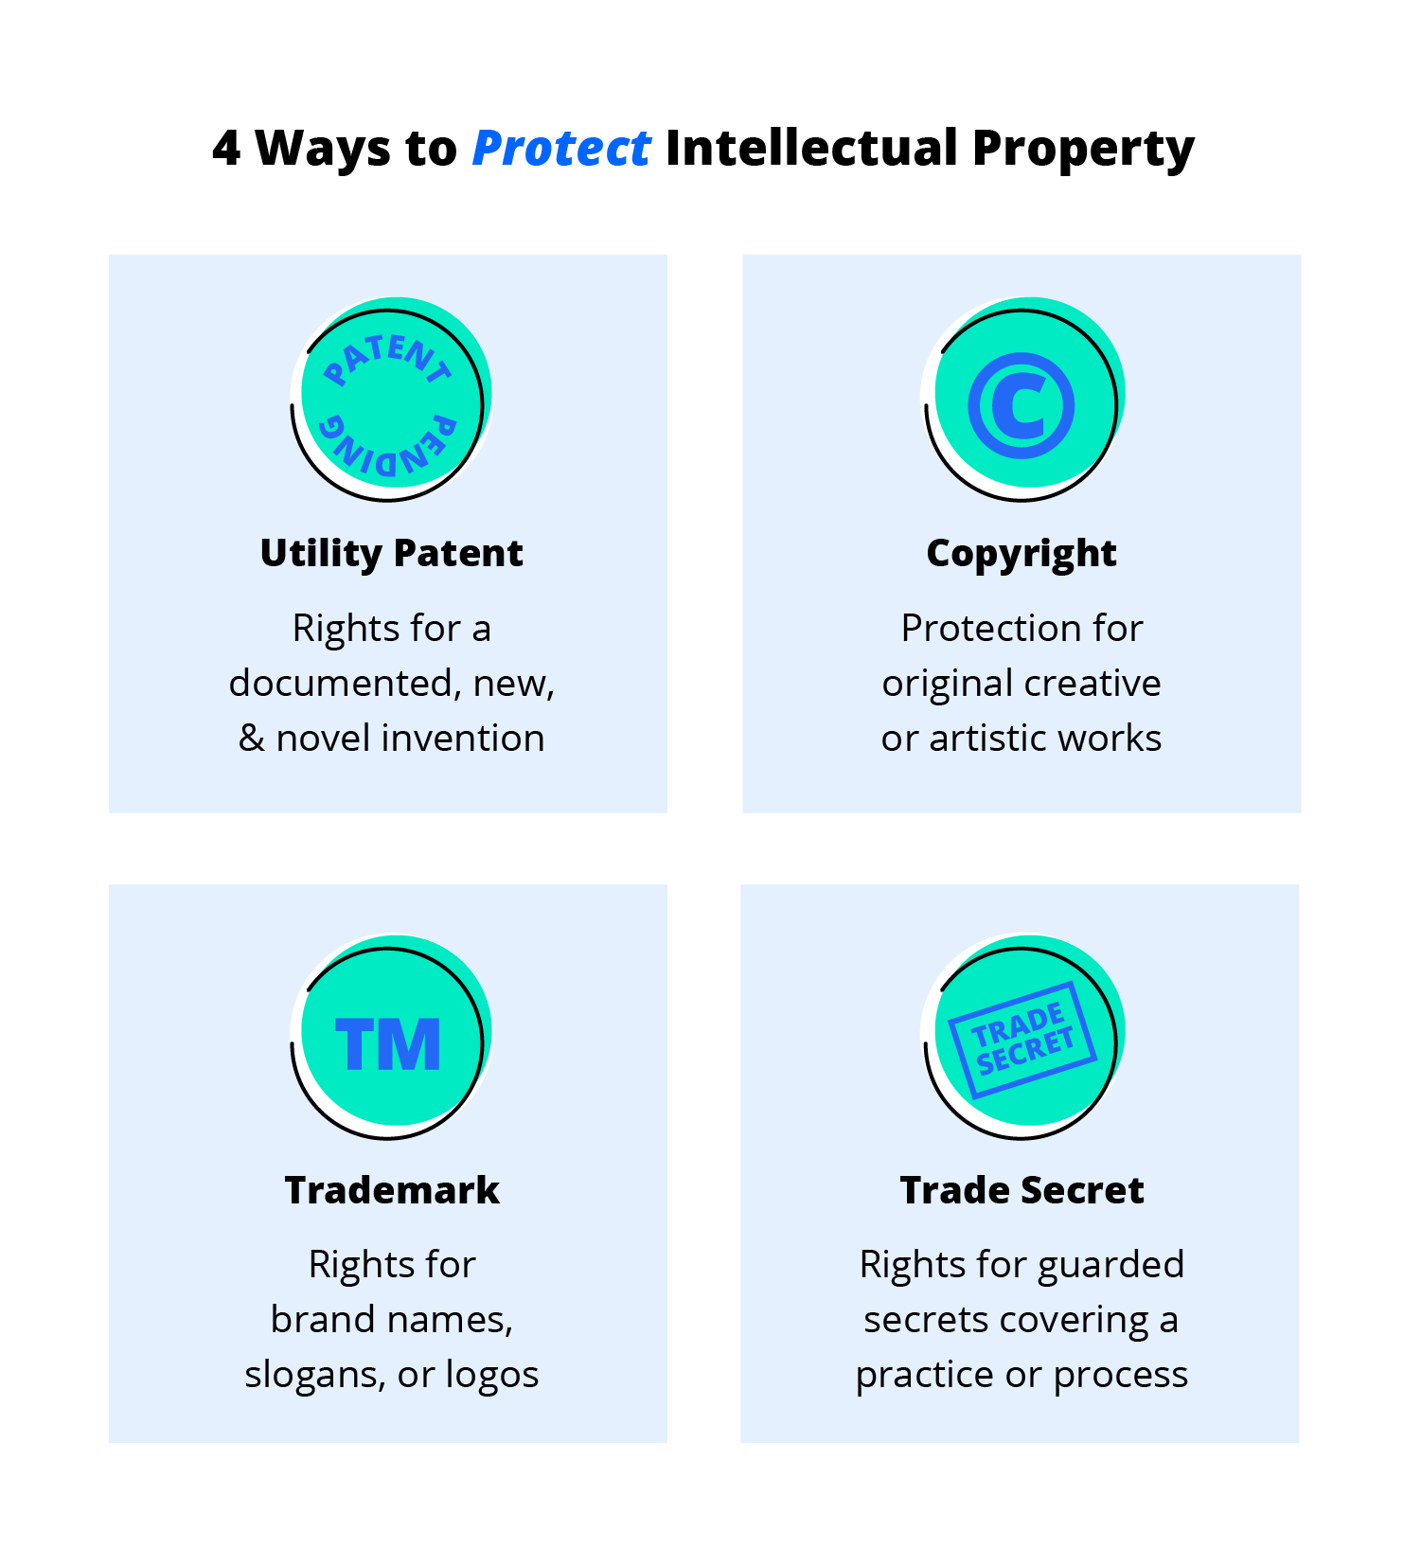
What are the 4 types of intellectual property protections?
Copyrights, trademarks, patents, and trade secrets are the four primary types of intellectual property protection.

Slide 14
4 tips for protecting intellectual property
Protecting your intellectual property is a means to secure an economic advantage for your business and make sure you can defend your unique ideas, products, and services. The best way to protect IP is to register it with the government and enforce your ownership rights.
Beyond registration and enforcement, you can protect certain types of intellectual property by:
Documenting your discoveries
Using digital rights management
Opting for strong nondisclosure agreements
Creating strong access credentials

Slide 15
Software Piracy
Software Piracy is the illegal approach of copying, distributing, modifying, selling, or using the software which is legally protected. So in a simple term, we can say Software piracy is the act of stealing legal software in an illegal way. This software piracy refers to the unauthorized copy and use of legal software. And now this critical problem has turned into a global issue.

Slide 16
Regulation for Software Piracy :
Software piracy is illegal and there are strict laws for these illegal activities. So monetary penalties are also there for this lawbreaker who breaks these copyright laws and creates copyright violation.
End-User License Agreement(EULA) is a license agreement which is mostly used for software to protect its legality. It is a contract between the manufacturer and the end-user. This rule defines the rules for legal software. One common rule in EULA is that it prevents the user from sharing the software with others.

Slide 17
Types of Software Piracy :
Softlifting-
It is the most common type of software piracy. In this piracy, the legal owner of the software is one, but the users are multiple.
Hard-disk Loading-
It is the most common type of software piracy which mainly happens in PC resell shops. The shop owner buys a legal copy of the software and reproduces its copies in multiple computers by installing it.
Counterfeiting-
In counterfeiting the duplicates are created of genuine/legal software programs with the appearance of authenticity. Then these duplicate software are sold out at less price.

Slide 18
Client-Server overuse –
In client-server overuse, more copies of the software are installed than it has licensed for. Mainly it has seen in local business sectors when they work under a local area n/w and install the software in all the computers for use by a number of employees which is an unauthorized practice.
Online Piracy-
In online piracy, the illegal software is acquired from online auction sites and blogs which is mainly achieved through the P2P(Peer to Peer) file-sharing system. As it is acquired by means of the Internet, often it is called Internet Piracy.
Software Piracy is a danger because:
Many times it fails or malfunction.
No warranty of the product as it is acquired by illegal way.
Risk of security issues.
No upgrade and improvement in features and functionality
High risk of virus and malware infection to the computer.

Slide 19
How copyrights protect software
As soon as you create a work in a tangible medium, such as a computer file, you have copyright in that work. Copyright protection gives the owner or licensee the right to control how other entities display, perform, distribute, copy, or create derivatives of the work.
Historically, most software is released under copyright licenses, and no further protection under patent law is utilized. Factors such as first mover advantage, understanding a particular market niche, or controlling distribution channels are used to gain market advantage.

Slide 20
How patents protect software
A patent, if issued, allows the owner to prohibit others from using the patented invention. For software, the patented invention is often a method of calculating something. The copyright protects the actual code itself, but would not stop someone else from creating their own code that implemented the same method. Depending on the specific software, desired commercialization pathway, and time to market, the additional step of pursuing a patent may or may not be worth the added expense.

